Slide 1
Project Management
CT050-3-3-PRMGT
06: Planning Projects
Part 3 - Quality, Resources & Communication

Slide 2
Topic & Structure of The Lesson
Knowledge area | Planning process | Outputs
Project quality management | Plan quality management | Quality management plan Quality metrics Project management plan updates Project documents updates
Project resource management | Plan resource management Estimate activity resources | Resource management plan Team charter Project document updates Resource requirements Basis of estimates Resource breakdown structure Project documents updates
Project communications management | Plan communications management | Communications management plan Project management plan updates Project documents updates

Slide 3
Learning Outcomes
At the end of this topic, You should be able to
List several planning processes and outputs for project quality, resource and communication management
Discuss the project quality management planning process, and explain the purpose and contents of a quality management plan and quality metrics
Explain the project resource management planning and estimate activity resources processes, and create a resource management plan, team charter, resource requirements, and a resource breakdown structure
Describe the project communications management planning process, and describe the importance of using a project communications management plan

Slide 4
Key Terms You Must Be Able To Use
If you have mastered this topic, you should be able to use the following terms correctly in your assignments and exams:
quality metrics
team charter
resource requirements
basis of estimates
resource breakdown structure
project website

Slide 5
Project Quality Management
Project quality management ensures that the project will satisfy the stated or implied needs for which it was undertaken
Key outputs produced as part of project quality management include a quality management plan, quality metrics, and updates to the project management plan and project documents

Slide 6
What Is Quality?
The International Organization for Standardization (ISO) defines quality as “the degree to which a set of inherent characteristics fulfill requirements” (ISO9000:2000)
Other experts define quality based on conformance to requirements and fitness for use.
Conformance to requirements means that the project’s processes and products meet written specifications
Fitness for use means that a product can be used as it was intended
The customer ultimately decides that the quality level is acceptable

Slide 7
Quality Planning and the Quality Management Plan
Quality planning includes identifying which quality standards are relevant to the project and how best to satisfy those standards
It also involves designing quality into the products of the project as well as the processes involved in managing the project
Like other plans, the size and complexity of quality management plans varies to meet project needs

Slide 8
Quality Metrics
A metric is a standard of measurement
Metrics allow organizations to measure their performance in certain areas and to compare them over time or with other organizations
Examples of common metrics used by organizations include failure rates of products produced, availability of goods and services, and customer satisfaction ratings

Slide 9
Project Resource Management
Many corporate executives have said, “People are our most important asset.” People determine the success and failure of organizations and projects
Project resource management is concerned with making effective use of the people involved with a project as well as physical resources (materials, facilities, equipment, and infrastructure)
The main outputs produced as part of project resource management planning are:
Project resource management plan (can be separated into a team management plan and a physical resource management plan)
Team charter

Slide 10
Team Management Plan
Key components include:
Project organizational chart
Responsibility assignment matrix
Resource histogram
Staffing management plan

Slide 11
Project Organizational Charts
Similar to a company’s organizational chart, a project organizational chart is a graphical representation of how authority and responsibility is distributed within the project
The size and complexity of the project determines how simple or complex the organizational chart is

Slide 12
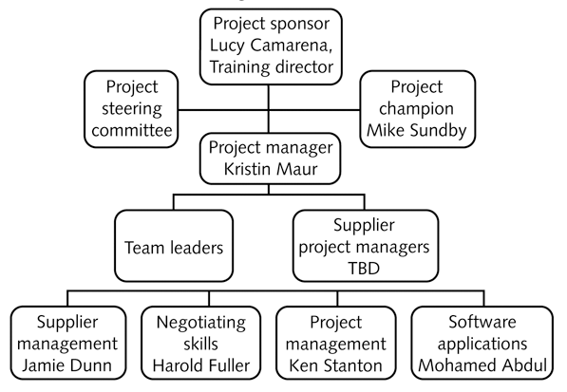
Sample Project Organizational Chart

Slide 13
Responsibility Assignment Matrices
A responsibility assignment matrix (RAM) is a matrix that maps the work of the project as described in the work breakdown structure (WBS) to the people responsible for performing the work
For smaller projects, it is best to assign WBS activities to individuals; for larger projects, it is more effective to assign the work to organizational units or teams
RACI charts are a type of RAM that show Responsibility (who does the task), Accountability (who signs off on the task or has authority for it), Consultation (who has information necessary to complete the task), and Informed (who needs to be notified of task status/results) roles for project stakeholders

Slide 14
Sample RACI Chart
Tasks | Kristin | Jamie | Mohamed | Supplier A
Needs assessment | A | R | C | I
Research of existing training | I | R, A | C | I
Partnerships | R, A | I | I | C
Course development | A | C | C | R
Course administration | I | A | R
Course evaluation | I | A | R | I
Stakeholder communications | R, A | C | C | C
R: Responsible A: Accountable C: Consulted I: Informed

Slide 15
Resource Histograms
A resource histogram is a column chart that shows the number of resources required for or assigned to a project over time
In planning project staffing needs, senior managers often create a resource histogram in which columns represent the number of people needed in each skill category. By stacking the columns, you can see the total number of people needed each month
After resources are assigned to a project, you can view a resource histogram for each person to see how his/her time has been allocated

Slide 16
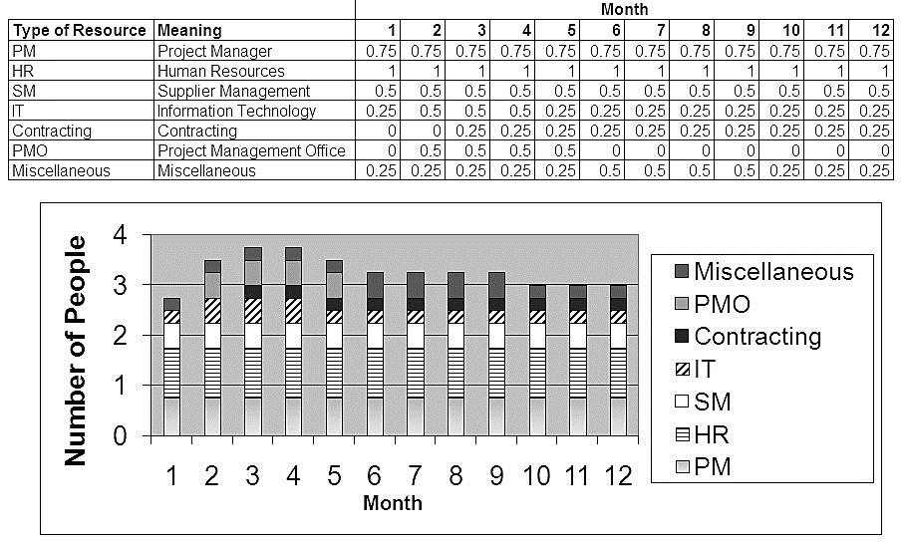
Sample Resource Histogram

Slide 17
Staffing Management Plans
A staffing management plan describes when and how people will be added to and removed from a project
It describes the types of people needed to work on the project, the numbers needed for each type of person each month, and how these resources will be acquired, trained, rewarded, and reassigned after the project

Slide 18
Team Charter
Many companies believe in using team charters to help promote teamwork and clarify team communications.
After core project team members have been selected, they meet to prepare a team charter to guide how the team will function.
It is crucial to emphasize the importance of the project team throughout the project’s life cycle, and the team charter should be updated as needed.

Slide 19
Estimating Activity Resources
Estimating activity resources involves estimating the type, quantity and characteristics of team resources and physical resources (i.e., materials, equipment, and supplies) required to complete the project.
This process is closely related to estimating activity durations and costs.
It is important that the people who help determine what resources are necessary include people who have experience and expertise in similar projects and with the organization performing the project.
Resource estimates should be updated as needed during the project.

Slide 20
Important Questions to Answer in Activity Resource Estimating
How difficult will it be to perform specific activities on this project?
Is there anything unique in the project’s scope statement that will affect resources?
Are there specific resources better suited to perform the activities?
What is the organization’s history in doing similar activities? Have they done similar activities before? What level of personnel did the work?
Does the organization have appropriate people, equipment, and materials available for performing the work? Are there any organizational policies that might affect the availability of resources?
Does the organization need to acquire more resources to accomplish the work? Would it make sense to outsource some of the work? Will outsourcing increase or decrease the amount of resources needed and their availability?
What assumptions have been made or need to be made?

Slide 21
Sample Resource Breakdown Structure
Just-In-Time Training Project
Internal Personnel
Equipment
Supplies
External Personnel
Training
IT
Training Classrooms
Training Books
Classroom Computers
Level 1
Level 2
Level 1
Level 2
Projection Systems

Slide 22
Project Communications Management
Many experts agree that the greatest threat to the success of any project is a failure to communicate
Many project managers say that 90 percent of their job is communicating, yet many project managers fail to take the time to plan for project communications
Project communications management involves generating, collecting, disseminating, and storing project information
Key outputs include a communications management plan and a project website

Slide 23
Communications Management Plans
Because project communication is so important, every project should include a communications management plan—a document that guides project communications
The plan will vary with the needs of the project, but some type of written plan should always be prepared and address the following items:
Stakeholder communications requirements
Information to be communicated, format, content, and level of detail
Identification of who will receive the information and who will produce it
Suggested methods or guidelines for conveying the information
Description of the frequency of communication
Escalation procedures for resolving issues
Revision procedures for updating the communications management plan
A glossary of common terminology used on the project

Slide 24
Project Websites
Project websites provide a centralized way of delivering project documents and other communications
Some project teams also create blogs—easy-to-use journals on the Web that allow users to write entries, create links, and upload pictures, while allowing readers to post comments to particular journal entries
Part of the Web site might be open to outside users, whereas other parts might be accessible only by certain stakeholders
It is important to decide if and how to use a project website to help meet project communications requirements

Slide 25
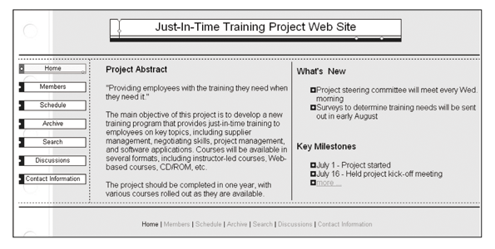
Sample Project Web Site

Slide 26
Quick Review Question

Slide 27
Summary of Main Teaching Points
This chapter summarizes the planning processes and outputs for quality, resource and communications.
Outputs include management plans for each knowledge area, quality metrics, team charter, resource requirements, basis of estimates, resource breakdown structure and project website.

Slide 28
Question and Answer Session
Q & A

Slide 29
What we will cover next
08 Planning Projects Part 3 (Stakeholder, Risk & Procurement)

